Slide 1
Introduction
FROM : M Mitwas
FA21-BCE-017
TO : RIZWAN SHEHZAD

Slide 2
Topic of presentation
Designing of forms
Reports Creation
Relationships

Slide 3
Forms
Forms are used to collect required information in a meaningful and logical manner to store into database.

Slide 4
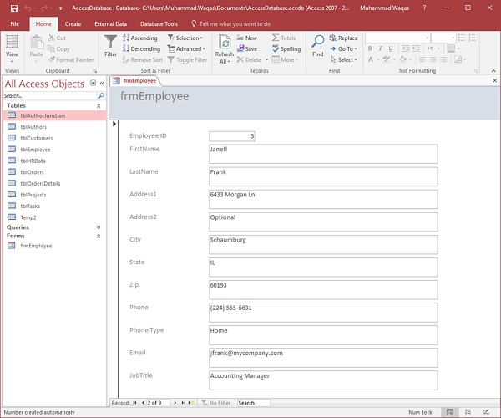
Example :

Slide 5
Reports
A report is a is a presentation of data that provides some information.
A report is a read-only file.

Slide 6
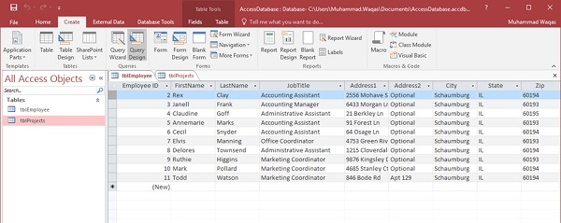
Example :

Slide 7
Relationships and its types
Relationship is a association between tables.
Tables are related by relationships to reduce data retundency.
There are three types of relationships, one-to-one, one-to-many and many-to-many relationships.

Slide 8
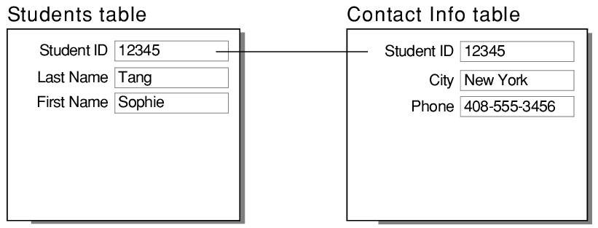
One-to-one :
In one to one relationship one record in a table is related to one and only one record on another table.

Slide 9
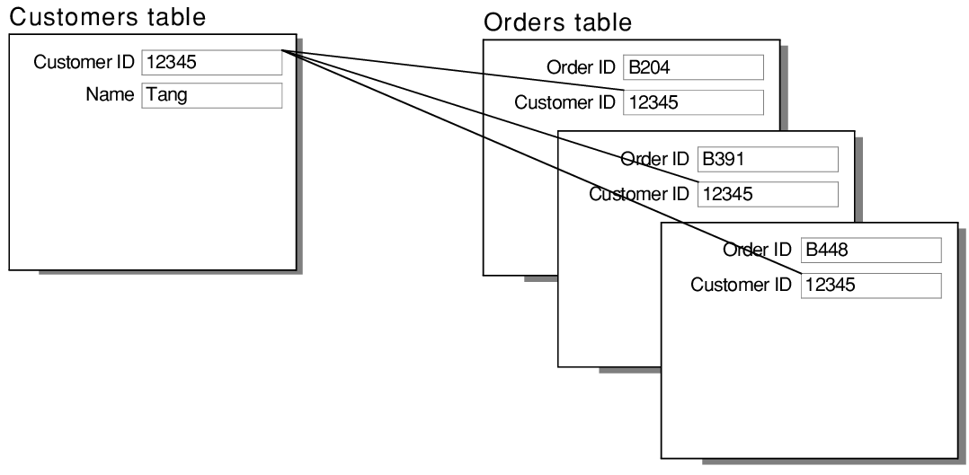
One to many :
In one to many relationship one row table A is related to many rows of table B.

Slide 10
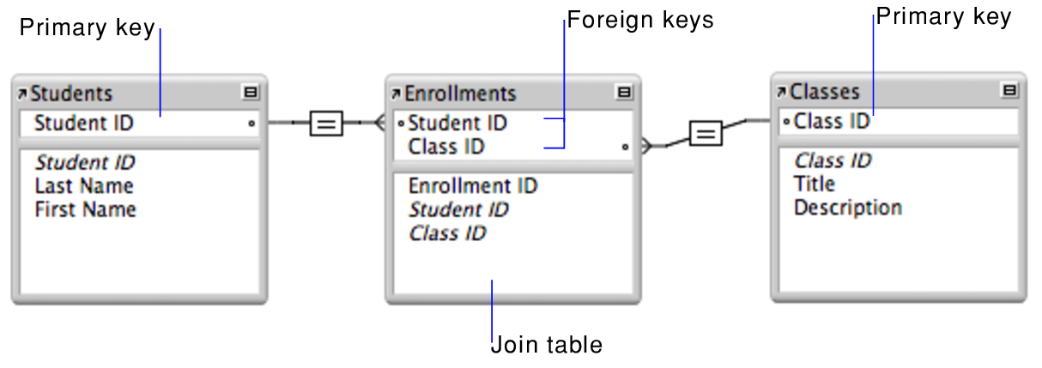
Many to many:
A many to many relationship exists when one or more items in table A is related to one or more item in table B.

